Slide 1







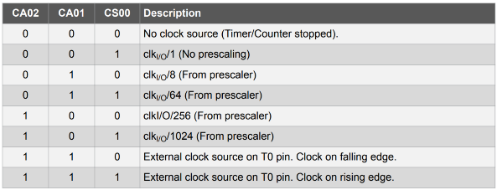
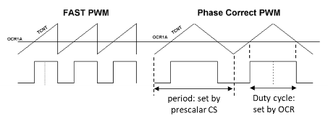
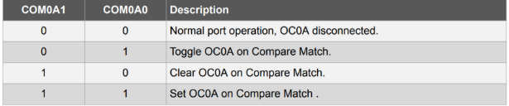

#include <avr/io.h>
#include <avr/interrupt.h>
#define F_CPU 16000000UL
#include <util/delay.h>
//delay() depends on TIMER0;
//use these two LoC to enable _delay_ms
#define LED__delay_ms 100
static volatile int turn=0;
static volatile unsigned long _timerTicks = 0;
//volatile: variable read straight from memory, not stored in storage register
//static: value only accessible in a single file
ISR(TIMER1_COMPA_vect) { //for INT0: ISR(INT0_vect)
_timerTicks++;
if (_timerTicks==5) {
turn = 1-turn;
_timerTicks=0;
}
}
void setupTimer() {
cli();
TCCR1A = 0;
TCCR1B = 0; //make sure clock hasn’t started
TIMSK1 = 0b10;
TCNT1 = 0;
OCR1A = 62499;
}
void startTimer() {
TCCR1B = 0b01100; //set to CTC mode
}
void setup() {
DDRB |= 0b00011000; //enable PB3, 4
//NOTE: 1 is output
setupTimer();
startTimer();
sei();
}
void loop() {
if(turn==0) flashGreen();
else flashRed();
}
void flashRed() { //flashGreen() similar
PORTB |= 0b00001000;
_delay_ms(LED__delay_ms);
PORTB &= 0b11110111;
_delay_ms(LED__delay_ms);
}
EICRA – External Interrupt Control Register A
ISC0 (Interrupt Sense Control for INT0)
EIMSK – External Interrupt Mask Register
TIMSKn – Timer Interrupt Mask Register
OCIE: Output compare interrupt enable
Enable TIMERn to generate interrupts when TCNTn = OCRnx
OCRnx – Output compare register
OCR0A, OCR0B; OCR2A, OCR2B; etc
When TCNTn reaches OCRnx, will output OCnx (at Arduino Pin)
TCCRnA, TCCRnB – Timer/Counter Compare Register
TCCR0/2A
TCCR0/2B
TCCR1B
CS – Clock Scalar
Timer 0, 2 – holds up to 8 bits
Timer 1 – can hold up to 16 bits
WGM – Waveform Generation Modes
COM – Compare Match
NOTE: Timer 2 has diff CS values
TIFRn – Timer Interrupt Flag Register
OCFA/B flags set to 1 when Timer Interrupt is triggered
If you don’t want to use interrupts

Slide 2
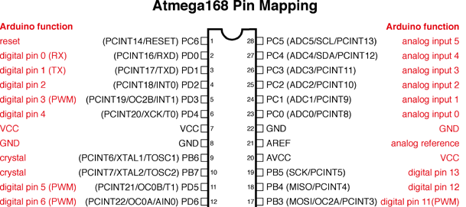
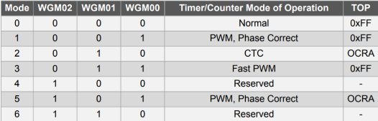
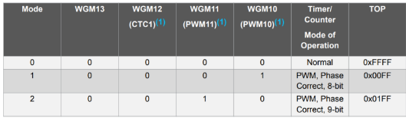
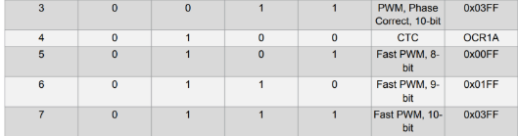
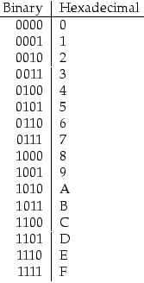
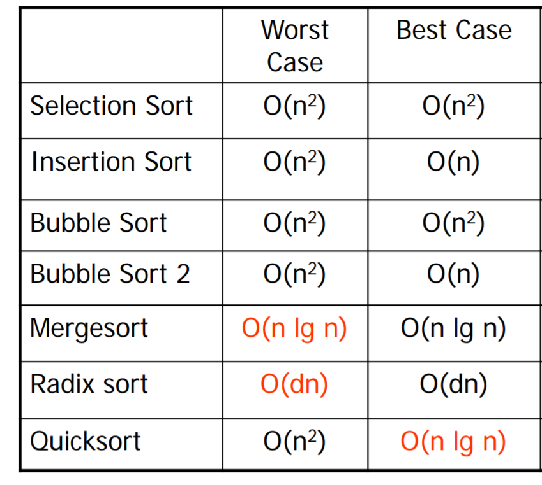
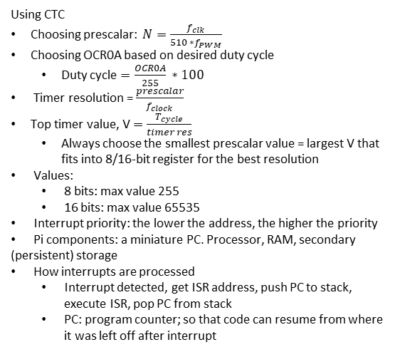
EXTRA
WGM Timer 0, 2
Using CTC
Choosing prescalar: $N=\frac{f_{clk}}{510 ∗f_{PWM}}$
Choosing OCR0A based on desired duty cycle
Duty cycle $=\frac{OCR0A}{255} ∗100$
Timer resolution = $\frac{prescalar}{f_{clock}}$
Top timer value, V $=\frac{T_{cycle}}{timer res}$
Always choose the smallest prescalar value = largest V that fits into 8/16-bit register for the best resolution
Values:
8 bits: max value 255
16 bits: max value 65535
Interrupt priority: the lower the address, the higher the priority
Pi components: a miniature PC. Processor, RAM, secondary (persistent) storage
How interrupts are processed
Interrupt detected, get ISR address, push PC to stack, execute ISR, pop PC from stack
PC: program counter; so that code can resume from where it was left off after interrupt
WGM Timer1
Debouncing
#define THRESHOLD 100
unsigned long lastTime = 0, currTime;
ISR(INT0_vect) {
currTime = millis();
if (currTime – lastTime > THRESHOLD) {
lastTime = currTime;
//do stuff
}
}

